Slide 1
Understanding Cost Functions & Gradient Descent
Welcome to this comprehensive guide on cost functions and gradient descent—fundamental concepts in machine learning optimization. Throughout this presentation, we'll break down these complex topics into intuitive explanations with practical examples.
Muhammad Saeed

Slide 2
What is a Cost Function?
Definition
Purpose
Goal
A cost function (or loss function) measures how well a machine learning model is performing. It calculates the error between the predicted output and the actual target values.
It provides a single numerical value that represents the model's overall performance, allowing us to quantitatively assess and improve predictions.
The objective is to minimize this function. Lower values indicate better performance as the model's predictions more closely match actual values.

Slide 3

The Mathematics of Cost Functions
Mean Squared Error (MSE)
For Linear Regression, the most common cost function is the Mean Squared Error (MSE):
J(θ) = (1/2m) ∑(hθ(x^(i)) - y^(i))²
Where:
J(θ) is the cost function
m is the number of training examples
hθ(x^(i)) is the predicted output
The function adds up the squared differences between predicted and actual values for all data points. Squaring ensures the error is positive and penalizes larger errors more significantly than smaller ones.
y^(i) is the actual output
θ represents model parameters (weights)

Slide 4



Interpreting the Cost Function
Error Measurement
Squared Differences
Minimization Target
The cost function quantifies the difference between what your model predicts and the actual values in your training data. It's essentially a measure of how "wrong" your model is.
By squaring the differences, we ensure all errors are positive and give more weight to larger errors, making them more significant in the calculation.
The ultimate goal is to find the model parameters that produce the smallest possible cost value, indicating the best fit to the training data.

Slide 5
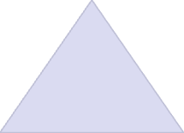

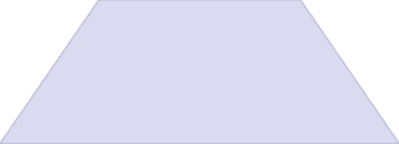

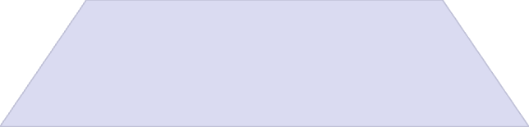

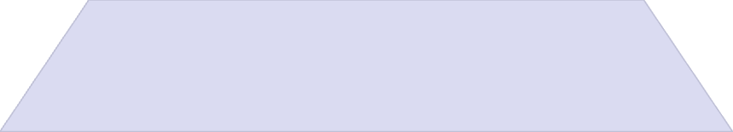

What is Gradient Descent?
Optimization Algorithm
Finds the minimum of the cost function
Parameter Updates
Adjusts model parameters step-by-step
Gradient Calculation
Uses derivatives to determine direction
Iterative Process
Repeats until convergence
Gradient Descent is an optimization algorithm used to minimize the cost function by updating the model's parameters step-by-step in the direction of the negative gradient. It's like finding the bottom of a valley by taking steps in the steepest downhill direction.

Slide 6

The Mathematics of Gradient Descent
Update Rule Formula
For each parameter θj, the update rule is:
θj := θj - α · ∂J(θ)/∂θj
Where:
α is the learning rate (a small positive value like 0.01)
∂J(θ)/∂θj is the partial derivative (gradient) of the cost function with respect to θj
The gradient tells us the direction of steepest increase in the cost function. By moving in the opposite direction (negative gradient), we descend toward the minimum cost. The learning rate controls how large each step is.

Slide 7
Interpreting Gradient Descent
Compute the Slope
Calculate the gradient (slope) of the cost function at the current position. This tells you which direction leads to the steepest increase in cost.
Move Downhill
Take a step in the opposite direction of the gradient (negative gradient) to decrease the cost. The size of this step is determined by the learning rate.
Repeat Until Convergence
Continue this process iteratively until the gradient becomes very small (close to zero), indicating you've reached a minimum where the cost function is as low as possible.

Slide 8








The Learning Rate Parameter
Too Small
Too Large
If α is too small, gradient descent will work correctly but will be very slow, requiring many iterations to converge.
If α is too large, gradient descent might overshoot the minimum, fail to converge, or even diverge completely.
Just Right
Adaptive Rates
An optimal learning rate allows the algorithm to converge efficiently without overshooting or taking too long.
Advanced algorithms can adjust the learning rate automatically during training for better performance.

Slide 9
Linear Regression Example Setup
The Model
The Dataset
Let's consider a simple linear regression model with one feature:
x (input)
y (actual)
1
2
hθ(x) = θ0 + θ1x
2
4
Where:
3
6
θ0 is the y-intercept
θ1 is the slope
Looking at this data, we can see that the relationship is y = 2x. Our goal is to learn the values of θ0 and θ1 so that the model predicts y as accurately as possible.
x is the input feature

Slide 10
Initializing the Learning Process
0
0
0.1
Initial θ0
Initial θ1
Learning Rate α
Starting y-intercept value
Starting slope value
Step size for updates
We begin the gradient descent process by initializing our model parameters. We'll start with θ0 = 0 (no y-intercept) and θ1 = 0 (no slope), meaning our initial model predicts y = 0 for any input x. We also set a learning rate α = 0.1 to control how quickly we update our parameters.
With these initial values, our hypothesis function is hθ(x) = 0 + 0·x = 0, which is clearly far from the true relationship y = 2x that we can observe in our data.

Slide 11
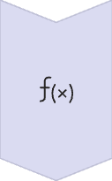


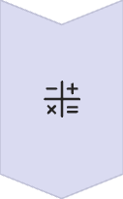
Calculating the Initial Cost
Apply Hypothesis Function
With θ0 = 0 and θ1 = 0, our model predicts h(x) = 0 for all inputs
Predictions: [0, 0, 0]
Calculate Errors
Subtract actual values from predictions
Errors: [0-2, 0-4, 0-6] = [-2, -4, -6]
Square the Errors
Square each error value
Squared Errors: [4, 16, 36]
Compute Cost Function
J(θ) = (1/2m) × sum of squared errors
J(θ) = (1/6) × (4+16+36) = (1/6) × 56 = 9.33

Slide 12
Computing the Gradients
Gradient for θ0
Gradient for θ1
The partial derivative of the cost function with respect to θ0 is:
The partial derivative of the cost function with respect to θ1 is:
∂J/∂θ0 = (1/m) ∑(hθ(x^(i)) - y^(i)))
∂J/∂θ1 = (1/m) ∑((hθ(x^(i)) - y^(i)) × x^(i))
Substituting our values:
Substituting our values:
∂J/∂θ0 = (1/3) × (-2-4-6) = (1/3) × (-12) = -4
∂J/∂θ1 = (1/3) × ((-2×1) + (-4×2) + (-6×3))
= (1/3) × (-2-8-18)
= (1/3) × (-28)
≈ -9.33

Slide 13



Updating the Parameters
Apply Update Rule
Use the gradient descent formula to update each parameter
Calculate New θ0
θ0 = 0 - 0.1 × (-4) = 0.4
Calculate New θ1
θ1 = 0 - 0.1 × (-9.33) ≈ 0.933
After our first update, the model parameters have changed from θ0 = 0, θ1 = 0 to θ0 = 0.4, θ1 = 0.933. Our hypothesis function is now hθ(x) = 0.4 + 0.933x, which is closer to the true relationship y = 2x than our initial model.
This is just the first iteration of gradient descent. We would continue this process, recalculating the cost, computing gradients, and updating parameters until convergence.

Slide 14








Iterating to Convergence
Calculate Cost
Compute Predictions
Measure error between predictions and actual values
Apply current model to input data
Update Parameters
Compute Gradients
Adjust model in direction that reduces cost
Find direction of steepest descent
This cycle repeats until the algorithm converges—when the cost function stops decreasing significantly or the gradients become very close to zero. With each iteration, our model parameters get closer to the optimal values of θ0 ≈ 0 and θ1 ≈ 2.
Eventually, our model will closely approximate the true relationship y = 2x that exists in our data.

Slide 15
Key Concepts Summary
Concept
Meaning
Cost Function
Measures how bad the model's predictions are
Gradient
The direction of steepest ascent (we move in the opposite direction)
Gradient Descent
Algorithm to find the parameters that minimize the cost function
Learning Rate
Controls how big a step we take each time

Slide 16



Real-World Analogy: Finding the Valley
The Blindfolded Hiker
Taking Steps Downhill
Reaching the Valley
Imagine you're blindfolded on a mountain and need to reach the lowest point (valley). You can only feel the slope under your feet. This is similar to how gradient descent works—the algorithm can only "feel" the local gradient, not see the entire landscape.
You take steps in the direction where the ground slopes downward most steeply. The size of your steps (learning rate) matters—too small and it takes forever, too large and you might overshoot or fall.
Eventually, you reach a point where the ground is flat in all directions—you've found a valley (minimum). This is equivalent to the algorithm converging to the optimal parameters where the cost is minimized.

Slide 17
Types of Gradient Descent
Batch Gradient Descent
Stochastic Gradient Descent (SGD)
Mini-Batch Gradient Descent
Uses the entire dataset to compute the gradient in each iteration. Computationally expensive for large datasets but provides a more accurate direction.
Uses a single random example to compute the gradient in each iteration. Much faster but results in noisy updates that may not always move directly toward the minimum.
A compromise between batch and stochastic approaches, using a small random subset of examples in each iteration. Combines the advantages of both methods.
Stable convergence
Fast computation
Balance of speed and stability
Computationally expensive
Less memory required
Memory intensive
Noisy convergence path
Widely used in practice
Parallelizable computation

Slide 18




Challenges in Gradient Descent
Local Minima
Saddle Points
Plateaus
Zigzagging
The algorithm may get stuck in a local minimum rather than finding the global minimum, especially in complex, non-convex cost functions with multiple valleys.
Flat regions where the gradient is very small, causing the algorithm to make very slow progress as the parameter updates become tiny.
In narrow valleys, the algorithm may bounce back and forth between the sides, making slow progress toward the minimum instead of moving directly down.
Points where the gradient is zero but are neither minima nor maxima. These can slow down convergence as the algorithm may stall when it encounters them.

Slide 19




Advanced Gradient Descent Algorithms
Momentum
AdaGrad
Adds a fraction of the previous update to the current one, helping to smooth out oscillations and accelerate convergence, especially in narrow valleys or plateaus.
Adapts the learning rate for each parameter based on historical gradients, giving smaller updates to frequently updated parameters and larger updates to infrequent ones.
RMSProp
Adam
Modifies AdaGrad to use an exponentially weighted moving average of squared gradients, preventing the learning rate from becoming too small over time.
Combines the benefits of momentum and adaptive learning rates, maintaining both a moving average of gradients and squared gradients for more efficient optimization.

Slide 20
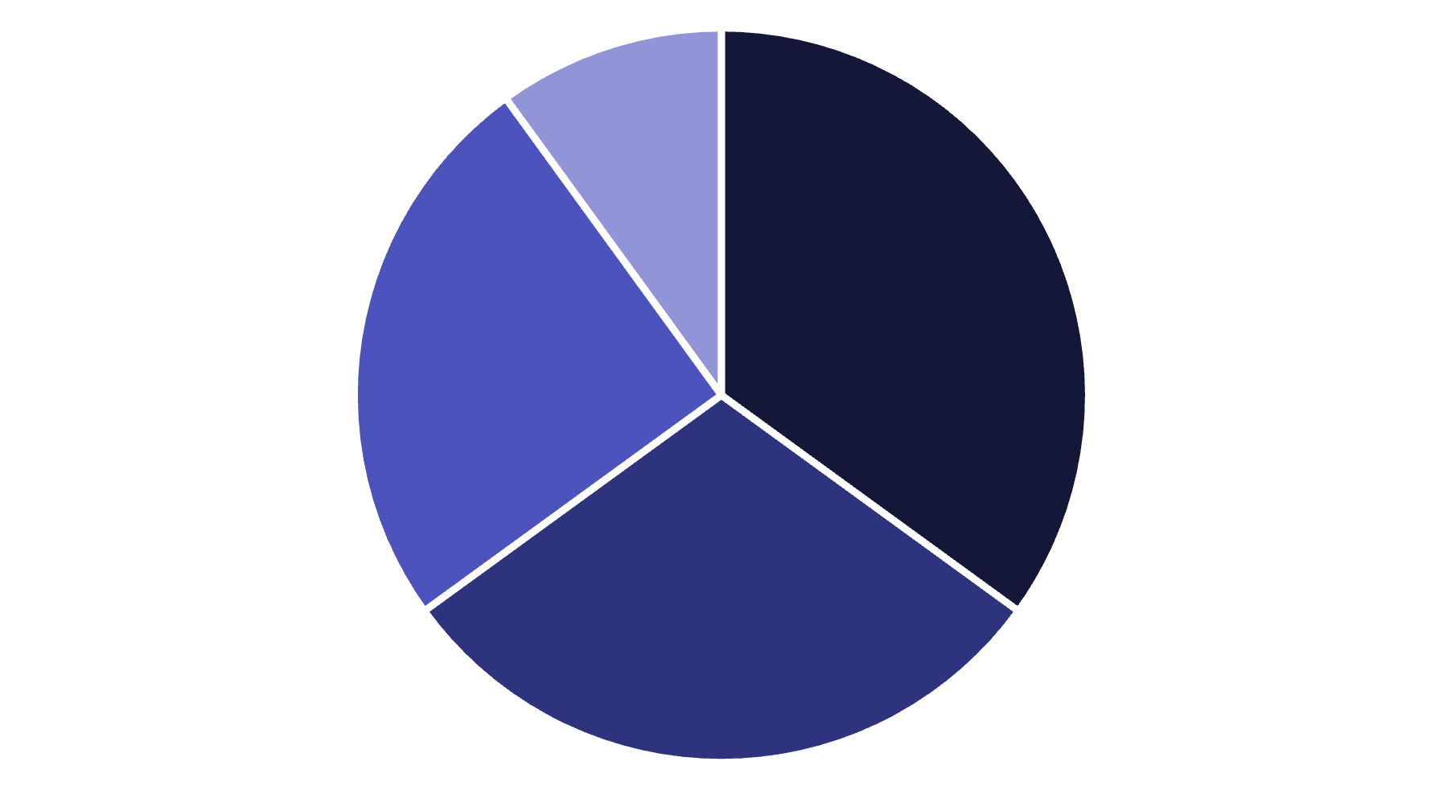
Cost Functions for Different Problems
Regression
Binary Classification
Multi-class Classification
Other
Different machine learning problems require different cost functions. For regression problems like our linear regression example, Mean Squared Error (MSE) is commonly used. Binary classification often uses Binary Cross-Entropy or Hinge Loss, while multi-class classification typically employs Categorical Cross-Entropy.
The choice of cost function significantly impacts model training and performance. Each is designed to capture the specific type of error relevant to the problem at hand.

Slide 21
Regularization in Cost Functions
What is Regularization?
Regularized Cost Function
Regularization adds a penalty term to the cost function to discourage complex models and prevent overfitting. It helps the model generalize better to unseen data by keeping the parameter values small.
J(θ)_reg = J(θ) + λ × R(θ)
Where:
Common Regularization Terms
J(θ) is the original cost function
R(θ) is the regularization term
L1 Regularization (Lasso): Adds the sum of absolute values of parameters
λ is the regularization parameter that controls the strength of the penalty
L2 Regularization (Ridge): Adds the sum of squared values of parameters
Larger values of λ result in simpler models with smaller parameter values, potentially reducing overfitting at the cost of increased bias.
Elastic Net: Combines both L1 and L2 regularization

Slide 22




Practical Implementation Considerations
Feature Scaling
Normalize features to have similar scales (e.g., mean 0, standard deviation 1) to help gradient descent converge faster and more reliably.
Parameter Initialization
Initialize parameters randomly but carefully—poor initialization can lead to slow convergence or getting stuck in suboptimal solutions.
Convergence Criteria
Define clear stopping conditions, such as a minimum change in cost or maximum number of iterations, to determine when to stop training.
Debugging
Monitor the cost function during training to ensure it's decreasing. If not, adjust the learning rate or check for implementation errors.

Slide 23
Python Implementation Example
import numpy as np import matplotlib.pyplot as plt # Sample data X = np.array([1, 2, 3]) y = np.array([2, 4, 6]) # Initialize parameters theta_0 = 0 theta_1 = 0 alpha = 0.1 iterations = 100 # Arrays to store history cost_history = [] theta_0_history = [] theta_1_history = [] # Gradient descent for i in range(iterations): # Predictions y_pred = theta_0 + theta_1 * X # Cost cost = (1/(2*len(X))) * np.sum((y_pred - y)**2) cost_history.append(cost) # Gradients d_theta_0 = (1/len(X)) * np.sum(y_pred - y) d_theta_1 = (1/len(X)) * np.sum((y_pred - y) * X) # Update parameters theta_0 = theta_0 - alpha * d_theta_0 theta_1 = theta_1 - alpha * d_theta_1 # Store parameters theta_0_history.append(theta_0) theta_1_history.append(theta_1) print(f"Final parameters: theta_0 = {theta_0}, theta_1 = {theta_1}") print(f"Final cost: {cost_history[-1]}")
Code Explanation
This Python implementation demonstrates gradient descent for our simple linear regression example. It:
Initializes parameters θ0 and θ1 to zero
Sets learning rate α to 0.1
Runs 100 iterations of gradient descent
Calculates predictions, cost, and gradients at each step
Updates parameters using the gradient descent rule
Tracks the history of cost and parameters
The final output shows that the algorithm converges to values very close to the true relationship y = 2x.

Slide 24




Key Takeaways & Next Steps
Cost Functions
Gradient Descent
Parameter Learning
Advanced Topics
Cost functions quantify model performance by measuring the difference between predictions and actual values. Minimizing this function is the goal of model training.
Gradient descent is an iterative optimization algorithm that finds the minimum of the cost function by taking steps in the direction of the negative gradient.
Through repeated application of gradient descent, models learn the optimal parameters that best fit the training data, enabling accurate predictions on new data.
Further exploration includes advanced optimization algorithms, regularization techniques, and applications to complex models like neural networks.

